Slide 1

DUBMIX
By: Jin Lee and RIchard Rodas

Slide 2
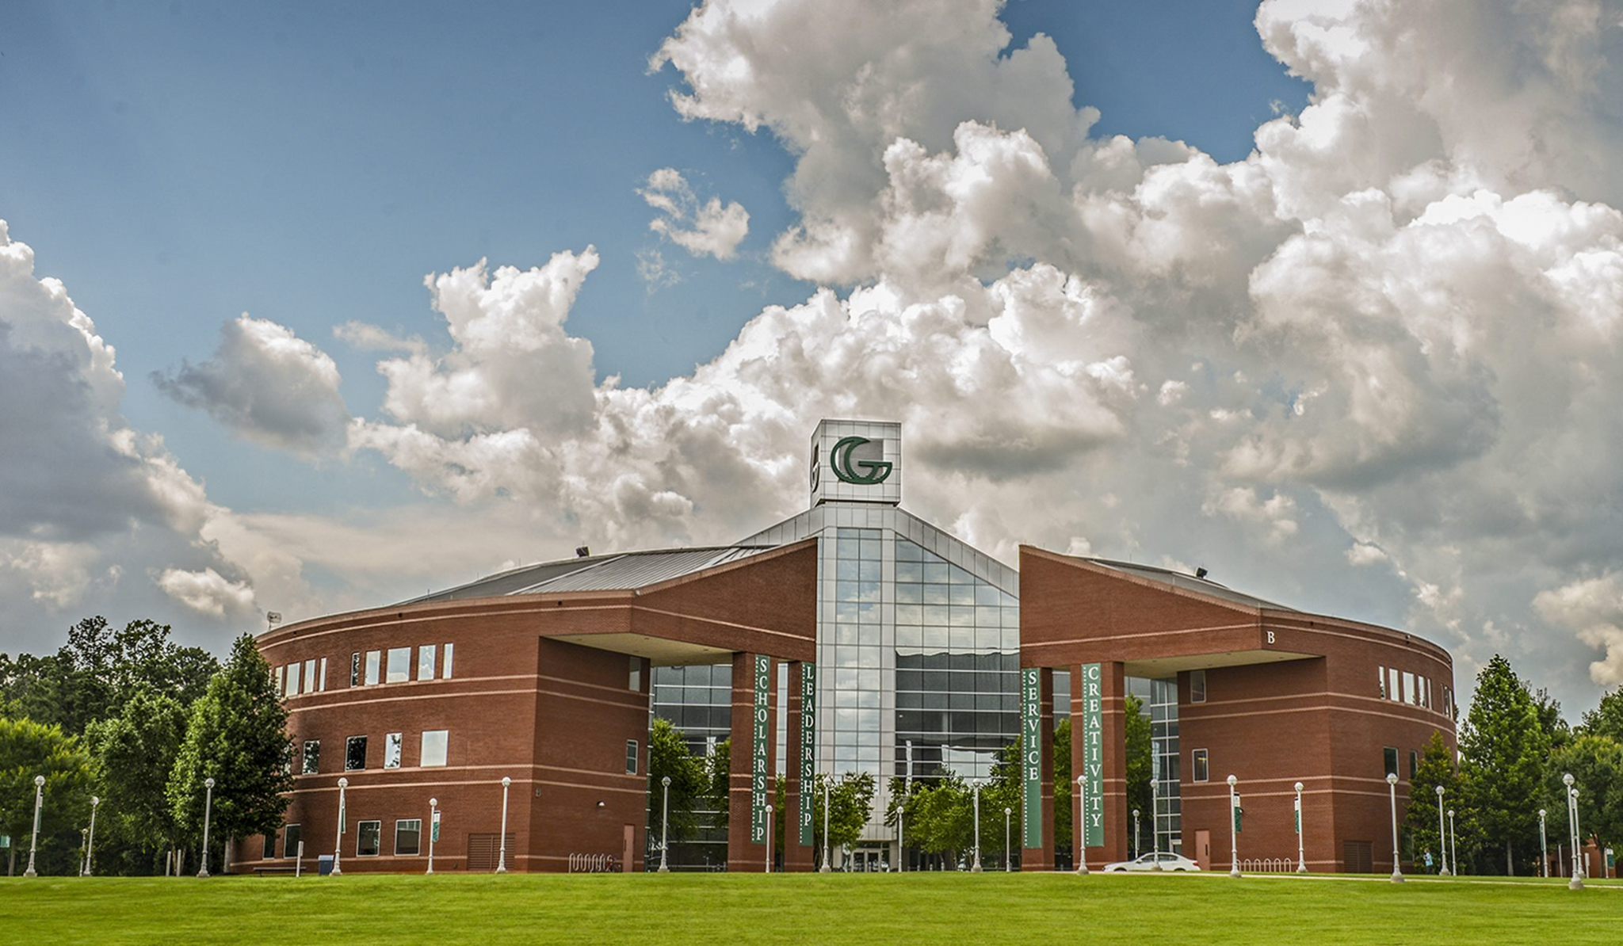

Technology Ambassadors Program (TAP)
What is TAP?
The Technology Ambassadors Program (TAP) is focus on commitment to service learning.
Work as a Team; brainstorm ideas for project
Host workshops for undecided, non-IT major students
Opened for anyone to join
Goal
Inspire non-IT students to join the IT field

Slide 3
Project Description
● DubMix is a workshop based around having students create their own music track via coding.
● The bulk of the educational aspect will take place in Ear Sketch.
○ Ear Sketch will give students hands on experience with introductory programming concepts such as: creating comments, creating variables, setting for loops, and calling functions.
○ In addition to programming students will also receive experience working in a DAW (Digital Audio Workstation) and producing their own music.

Slide 4


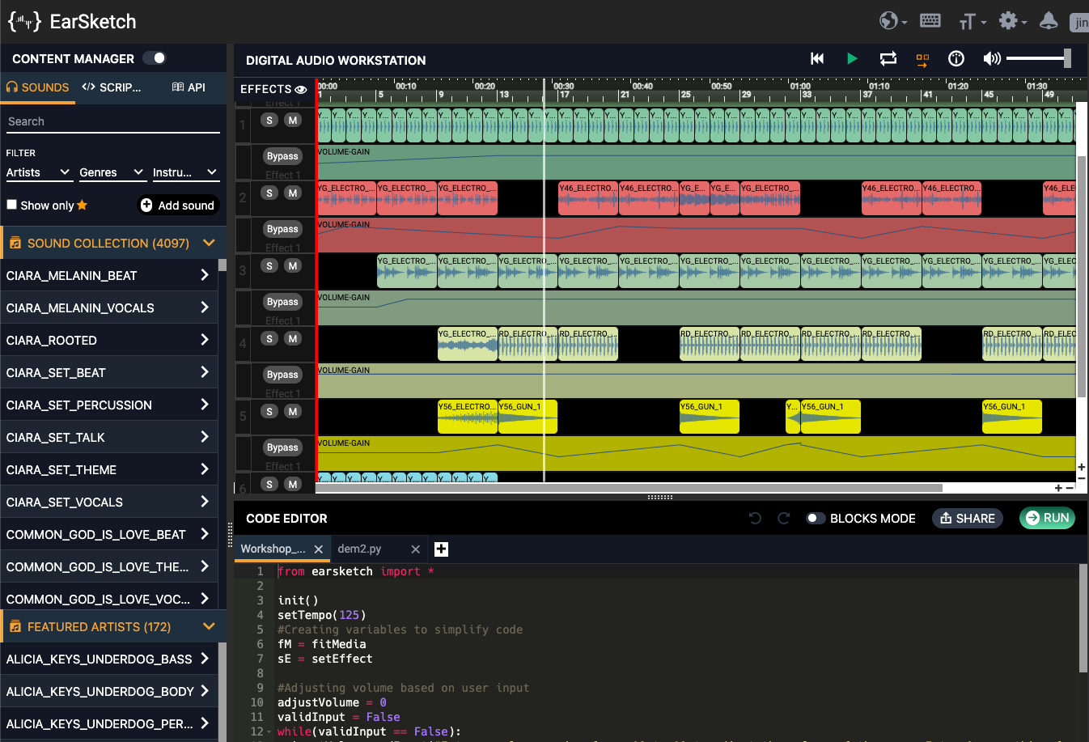
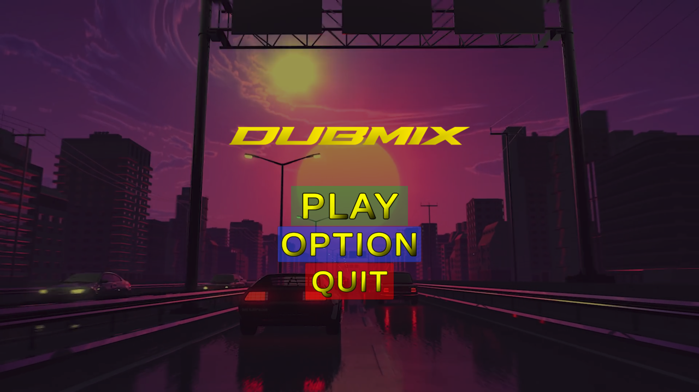

Project: DubMix
01
02
Rhythm Game

Slide 5
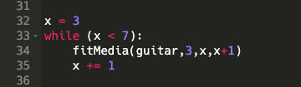
While Loop
A “While Loop” is used to execute a block of statements repeatedly until a given condition is satisfied.
Loop repeats until x becomes 6
X is defined as 3
The loop will start from measure 3
if x is 3, the track will starts from 3 and ends on 4 (3+1)
X will increase by 1 after each loop

Slide 6
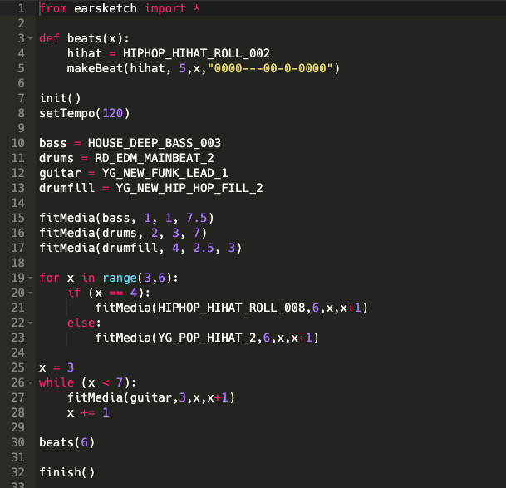
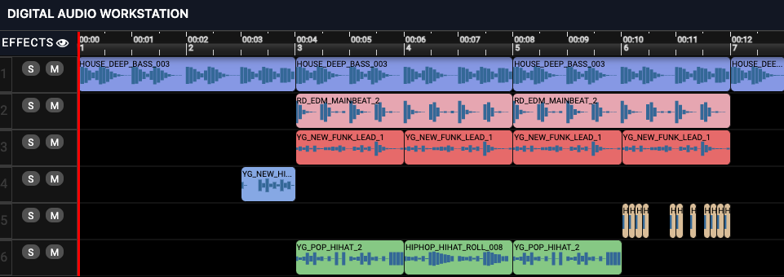
Notes:
from earsketch import *
def beats(x):
hihat = HIPHOP_HIHAT_ROLL_002
makeBeat(hihat, 5,x,"0000---00-0-0000")
init()
setTempo(120)
bass = HOUSE_DEEP_BASS_003
drums = RD_EDM_MAINBEAT_2
guitar = YG_NEW_FUNK_LEAD_1
drumfill = YG_NEW_HIP_HOP_FILL_2
fitMedia(bass, 1, 1, 7.5)
fitMedia(drums, 2, 3, 7)
fitMedia(drumfill, 4, 2.5, 3)
for x in range(3,6):
if (x == 4):
fitMedia(HIPHOP_HIHAT_ROLL_008,6,x,x+1)
else:
fitMedia(YG_POP_HIHAT_2,6,x,x+1)
x = 3
while (x < 7): # You can use <,or >,or <=,or >=.
fitMedia(guitar,3,x,x+1)
x += 1
beats(6)
finish()

Slide 7
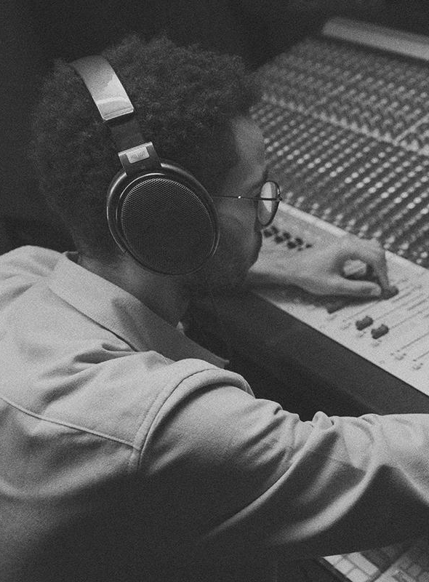
02
Results
Results
Results
Analytics

Slide 8
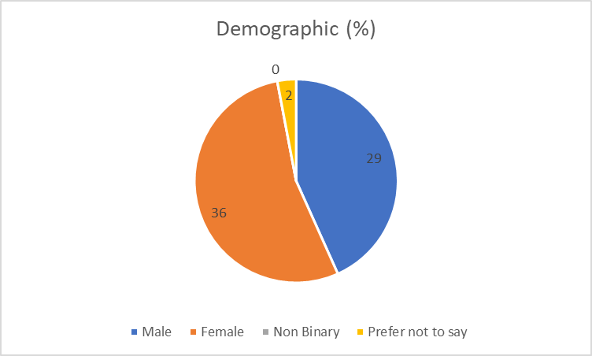
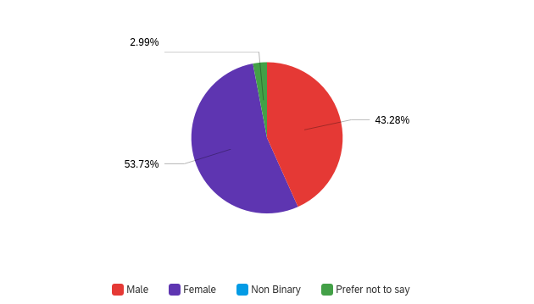
Workshop
Population
Gender

Slide 9
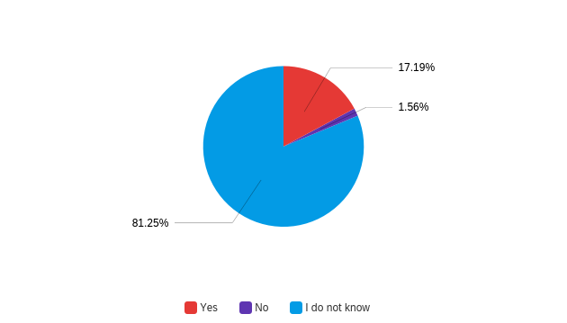
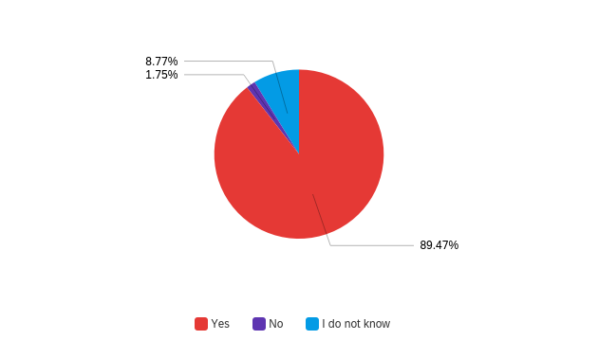
Is Python Case Sensitive?
Pre-Survey
Post-Survey
*Red is the correct answer

Slide 10
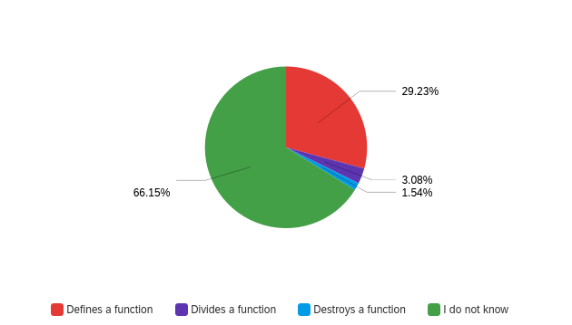
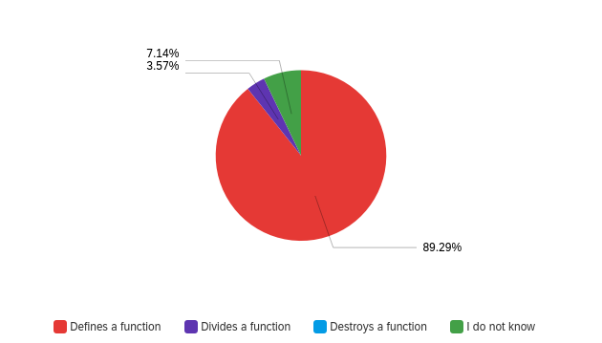
How Do You Define a Function?
Pre-Survey
Post-Survey
*Red is the correct answer

Slide 11
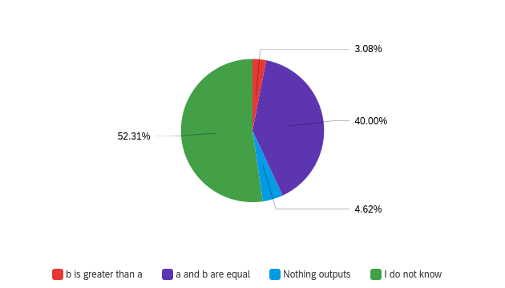
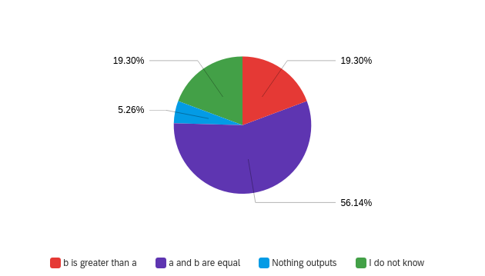
If-Else Statement
Pre-Survey
Post-Survey
*Purple is the correct answer

Slide 12
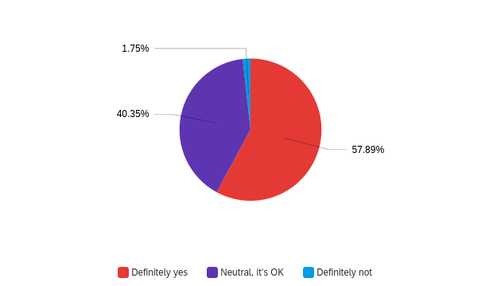
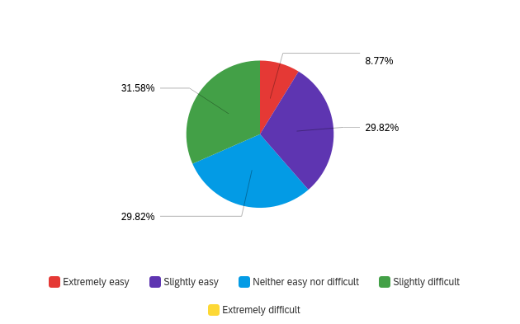
Did You Enjoy Learning a New Technology?
How Hard Is It To Learn New Technology?

Slide 13
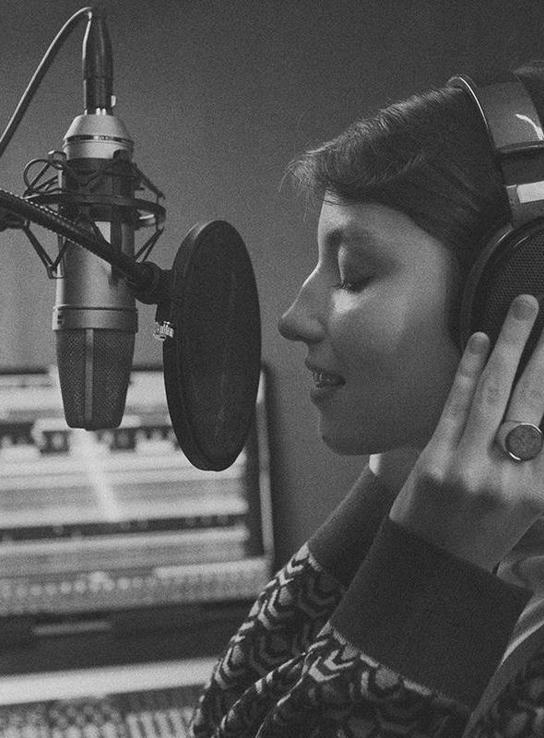
QUESTIONS?
QUESTIONS?
QUESTIONS?

